Slide 1


Navigating Screens in Jetpack Compose
Shreyas Patil
Google Developers Expert for
Android Developer @Paytm Insider
India

Slide 2
What’s navigation?

Slide 3
Navigation refers to the interactions that allow users to navigate across, into, and back out from the different pieces of content within your application.

Slide 4
How we achieved navigation earlier?

Slide 5
Jetpack Navigation
It consisted three parts
Navigation Graph
NavHost
NavController

Slide 6
Navigation Graph
<navigation
...
android:id="@+id/nav_graph"
app:startDestination="@id/notesFragment">
<fragment
android:id="@+id/loginFragment"
...
tools:layout="@layout/login_fragment">
<action
android:id="@+id/action_loginFragment_to_notesFragment"
app:destination="@id/notesFragment"
... />
<action
android:id="@+id/action_loginFragment_to_registerFragment"
... />
</fragment>
<fragment
...
</fragment>
</navigation>

Slide 7
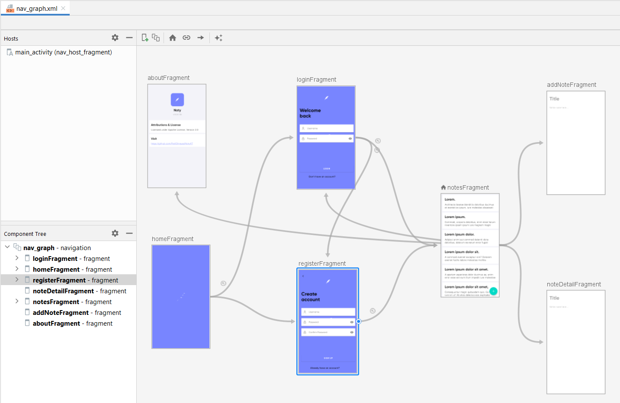
Navigation Graph
Source: NotyKT

Slide 8
Setting up NavHost
class MainActivity : AppCompatActivity() {
override fun onCreate(savedInstanceState: Bundle?) {
...
val navHostFragment: NavHostFragment = supportFragmentManager
.findFragmentById(R.id.nav_host_fragment) as NavHostFragment? ?: return
with(navHostFragment.navController) { ... }
}
}

Slide 9
Handling with NavController
class LoginFragment : Fragment() {
private fun onLoginSuccess() {
findNavController().navigate(R.id.action_loginFragment_to_notesFragment)
}
}

Slide 10
Using Compose Navigation

Slide 11
Jetpack Compose Navigation allows you to navigate between Composable screens by leveraging features of Navigation component.
😎

Slide 12
Why Jetpack Compose Navigation?

Slide 13
Why Jetpack Compose Navigation?
Can leverage Single-activity architecture

Slide 14
Why Jetpack Compose Navigation?
Can leverage Single-activity architecture
Easy to get NavHostController reference in @Composable functions

Slide 15
Why Jetpack Compose Navigation?
Can leverage Single-activity architecture
Easy to get NavHostController reference in @Composable functions
Decoupling dependencies and UI screen

Slide 16
Why Jetpack Compose Navigation?
Can leverage Single-activity architecture
Easy to get NavHostController reference in @Composable functions
Decoupling dependencies and UI screen
Easy to test navigation logic

Slide 17
Add dependency
Add a below dependency in your Jetpack Compose Application module
dependencies {
// Compose Navigation
implementation "androidx.navigation:navigation-compose:2.4.0-alpha10"
}

Slide 18
Setting up Activity
You won’t need additional setup for this!
class MainActivity : AppCompatActivity() {
override fun onCreate(savedInstanceState: Bundle?) {
super.onCreate(savedInstanceState)
setContent {
YourAppTheme {
MainNavigation()
}
}
}
}

Slide 19
Get the NavController
The NavController is the central API for the Navigation component.
It is stateful and keeps track of the back stack of composables that make up the screens in your app and the state of each screen.
@Composable
fun MainNavigation() {
val navController = rememberNavController()
...
}

Slide 20
Create the NavHost
@Composable
fun MainNavigation() {
val navController = rememberNavController()
NavHost(navController, startDestination = "notes") {
composable("notes") { NotesScreen(...) }
composable("addNote") { AddNoteScreen(...) }
composable("login") { LoginScreen(...) }
composable("signup") { SignUpScreen(...) }
composable("about") { AboutScreen(...) }
}
}

Slide 21
Create the NavHost
@Composable
fun MainNavigation() {
val navController = rememberNavController()
NavHost(navController, startDestination = "notes") {
composable("notes") { NotesScreen(...) }
composable("addNote") { AddNoteScreen(...) }
composable("login") { LoginScreen(...) }
composable("signup") { SignUpScreen(...) }
composable("about") { AboutScreen(...) }
}
}
this: NavGraphBuilder

Slide 22
Create the NavHost
@Composable
fun MainNavigation() {
val navController = rememberNavController()
NavHost(navController, startDestination = "notes") {
composable("notes") { NotesScreen(...) }
composable("addNote") { AddNoteScreen(...) }
composable("login") { LoginScreen(...) }
composable("signup") { SignUpScreen(...) }
composable("about") { AboutScreen(...) }
}
}
Route
@Composable screen

Slide 23
Create the NavHost
@Composable
fun MainNavigation() {
val navController = rememberNavController()
NavHost(navController, startDestination = "notes") {
composable("notes") { NotesScreen(...) }
composable("addNote") { AddNoteScreen(...) }
composable("login") { LoginScreen(...) }
composable("signup") { SignUpScreen(...) }
composable("about") { AboutScreen(...) }
}
}

Slide 24
Navigating screens

Slide 25
Navigating to the composable
@Composable
fun MainNavigation() {
val navController = rememberNavController()
NavHost(navController, startDestination = "notes") {
composable("notes") { NotesScreen(navController) }
composable("addNote") { AddNoteScreen(navController) }
composable("login") { LoginScreen(navController) }
composable("signup") { SignUpScreen(navController) }
composable("about") { AboutScreen(navController) }
}
}

Slide 26
Navigating to the composable
Use navigate() method to simply navigate to another composable
Provide it a route name.
@Composable
fun NotesScreen(navController: NavController) {
// On click 'Add' button -> Navigate to "Add Note" screen
navController.navigate("addNote")
}

Slide 27
Navigating with options

Slide 28
Navigating with options
// Pop everything up to the "login" destination off the back stack before
// navigating to the "notes" destination
navController.navigate("notes") {
popUpTo("login")
}
// Pop everything up to and including the "login" destination off
// the back stack before navigating to the "notes" destination
navController.navigate("notes") {
popUpTo("login") { inclusive = true }
}
// Navigate to the "notes” destination only if we’re not already on the "notes"
// destination, avoiding multiple copies on the top of the back stack.
navController.navigate("notes") {
launchSingleTop = true
}

Slide 29
Navigating with options
Can modify additional navigation options to navigate() call.
@Composable
fun LoginScreen(navController: NavController) {
// On Successful Login -> Navigate to "Notes" screen
navController.navigate("notes") {
// Pop everything up to and including the "login"
// destination from the back stack before
// navigating to the "notes" destination
popUpTo("login") { inclusive = true }
}
}

Slide 30
Navigating back
Use navigateUp() method to simply navigate back to the previous screen.
@Composable
fun AddNoteScreen(navController: NavController) {
// On click 'Back' Icon -> Go back
navController.navigateUp()
}

Slide 31
Dialog in Navigation

Slide 32
Dialog in Navigation
We can add composable to the navigation graph which will be hosted inside Compose’s Dialog.
This is suitable only when this dialog represents a separate screen in your app.

Slide 33
Dialog in Navigation
@Composable
fun MainNavigation() {
val navController = rememberNavController()
NavHost(navController, startDestination = "notes") {
...
dialog("exit") {
ExitDialog(...)
}
}
}
@Composable
fun NotesScreen(...) {
BackHandler { navController.navigate("exit") }
}

Slide 34
Dialog in Navigation
@Composable
fun MainNavigation() {
val navController = rememberNavController()
NavHost(navController, startDestination = "notes") {
...
dialog("exit") {
ExitDialog(navController)
}
}
}
@Composable
fun NotesScreen(...) {
BackHandler { navController.navigate("exit") }
}

Slide 35
Navigating with arguments

Slide 36
Navigating with Arguments (Define)
@Composable
fun NoteDetailScreen(navController: NavController, noteId: String) {
...
}
NavHost(navController, startDestination = "notes") {
...
composable(
route = "notes/{noteId}",
arguments = listOf(navArgument("noteId") { type = NavType.StringType })
) { backStackEntry ->
val noteId = requireNotNull(backStackEntry.arguments?.getString("noteId"))
NoteDetailScreen(navController = navController, noteId = noteId)
}
}

Slide 37
Navigating with Arguments (Usage)
@Composable
fun NotesScreen(navController: NavController) {
// On Click specific note -> Open details screen of that note
navController.navigate("notes/abcd1234")
}

Slide 38
Navigating with Optional Arguments (Define)
@Composable
fun NotesScreen(navController: NavController, additionalDetails: String?) {...}
NavHost(navController, startDestination = "notes") {
composable(
route = "notes?additional={details}",
arguments = listOf(
navArgument("details") {
nullable = true
defaultValue = null
}
)
) { backStackEntry ->
val additionalDetails = backStackEntry.arguments?.getString("details")
NotesScreen(navController, additionalDetails)
}
}
Syntax: ?argName={argName}

Slide 39
Navigating with Optional Arguments (Usage)
@Composable
fun SignUpScreen(navController: NavController) {
// On Successful SignUp -> Navigate to Notes screen with additional details
navController.navigate("notes?additional=newUserRegistration")
}

Slide 40
Deep linking support

Slide 41
Navigating with Deep links
val uri = "https://example.com"
composable(
"notes/{noteId}",
deepLinks = listOf(navDeepLink { uriPattern = "$uri/{noteId}" })
) { backStackEntry ->
val noteId = backStackEntry.arguments?.getString("noteId")
NoteDetailsScreen(navController, noteId)
}

Slide 42
Declare in Manifest
<activity android:name=".ui.MainActivity">
...
<intent-filter>
<data
android:host="www.example.com"
android:scheme="https" />
</intent-filter>
</activity>

Slide 43
Hilt and Navigation

Slide 44
Hilt and Navigation
Hilt also integrates with the Compose navigation library.
Add the following additional dependencies to your application’s Gradle file
dependencies {
// Hilt Compose Navigation
implementation "androidx.hilt:hilt-navigation-compose:1.0.0-alpha03"
}

Slide 45
Hilt and Navigation
If your ViewModel is annotated with @HiltViewModel then you can use hiltViewModel() composable function for getting instance of ViewModel.
The Activity should be annotated with @AndroidEntryPoint to support injection.
@HiltViewModel
class NotesViewModel @Inject constructor(...) : ViewModel() { ... }
@AndroidEntryPoint
class MainActivity : AppCompatActivity() {...}

Slide 46
Hilt and Navigation
@Composable
fun NotesScreen(navController: NavController, viewModel: NotesViewModel) {
...
}
@Composable
fun MainNavigation() {
val navController = rememberNavController()
NavHost(navController, startDestination = "notes") {
composable("notes") {
NotesScreen(navController, viewModel = hiltViewModel())
}
}
}
@Composable function from Hilt compose navigation library

Slide 47
References

Slide 48
References
Official Docs:
https://developer.android.com/jetpack/compose
https://developer.android.com/jetpack/compose/navigation
https://developer.android.com/jetpack/compose/libraries
Official GitHub Repo
https://github.com/android/compose-samples
Other GitHub Repo
https://github.com/bhavnathacker/ComposeDemo
https://github.com/PatilShreyas/NotyKT

Slide 49
Interview Questions
👨‍💻

Slide 50
What are the benefits of Jetpack compose over the Traditional Android UI toolkit?
What are the benefits of Jetpack compose over the Traditional Android UI toolkit?
Jetpack compose offers advantages:
Loose coupling between UI and Business logic
Simplified and Accelerated development
Less Boilerplate code
Better Code Structuring and Reusability

Slide 51
While using navigation, If you want to avoid making multiple copies of a Composable screen, how this can be achieved?
What are the benefits of Jetpack compose over the Traditional Android UI toolkit?
By enabling the flag launchSingleTop = true
In the builder While navigating to the destination route.
This won’t create multiple copies for the destination

Slide 52
When to use
Row / Column and
LazyRow / LazyColumn?
What are the benefits of Jetpack compose over the Traditional Android UI toolkit?
Row: Horizontal Linear Layout
Column: Vertical Linear Layout
LazyRow: Horizontal Scrolling List
LazyColumn: Vertical Scrolling List

Slide 53
While using Compose navigation,
Composable screen ‘A’ is currently visible and no other screen in the backstack.
If Composable screen ‘B’ is launched from navigation with modified options as popUpTo(‘A’) with inclusive flag as true
If the user presses the back button from screen ‘B’, what will happen?
What are the benefits of Jetpack compose over the Traditional Android UI toolkit?
Screen ‘A’ will be popped from the back stack (because inclusive flag is set to true) and Screen ‘B’ will be launched. Thus now Screen ‘B’ becomes the one and only Screen in the backstack. So application will be closed if the user pressed the back button.

Slide 54
What is the role of Modifiers in @Composables?
What are the benefits of Jetpack compose over the Traditional Android UI toolkit?
Modifiers either decorate or add behaviours to compose UI elements.
For example, backgrounds, padding and click event listeners decorate or add behavior to rows, text or buttons

Slide 55
Thank you!

